Slide 1
PHYTHON - 9
OOPS

Slide 2
Agenda
Introduction
3 Pillars
Class/ Object Introduction
Encapsulation
Inheritance
Polymorphism

Slide 3
Introduction

Slide 4
Introduction
Input
Process
Output
inp = input(‘Enter Number?’)
num = int(inp) + 1
print(‘Number Incremented’, num)

Slide 5

Object Oriented
A program is made up of many cooperating objects
Instead of being the “whole program” - each object is a self contained program and cooperatively working with other objects
A program is made up of one or more objects working together - objects make use of each other’s capabilities
Input
Dictionary
Object
Object
Output
String
Objects get created and used

Slide 6
Terminology
Class - a template/ protocol / blueprint/ design
Method or Message - A defined capability of a class
Field or attribute- A bit of data in a class
Object or Instance - A particular instance of a class / Implementation
Objects get created and used

Slide 7
3 Pillars

Slide 8
3 Pillars of Object Oriented Programming
Encapsulation
Inheritance
Polymorphism
Objects get created and used

Slide 9


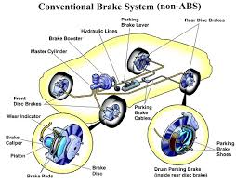
3 Pillars of Object Oriented Programming
Encapsulation
Inheritance
Polymorphism
Information Hiding
User must know only abstraction
Objects get created and used

Slide 10
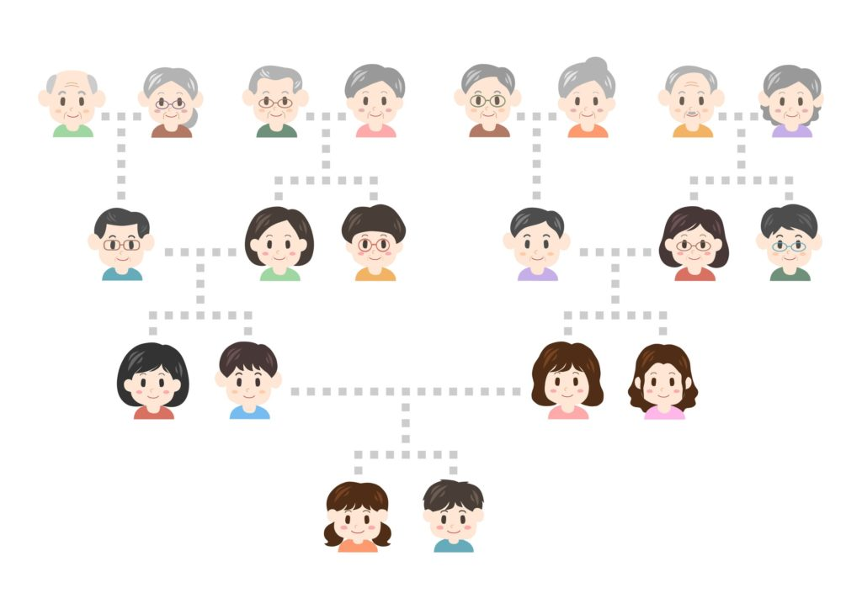
3 Pillars of Object Oriented Programming
Encapsulation
Inheritance
Polymorphism
Inherent behaviors
Posses Parents assets
Objects get created and used

Slide 11
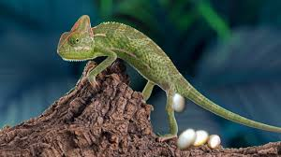
3 Pillars of Object Oriented Programming
Encapsulation
Inheritance
Polymorphism
Function/Operator works differently based on the different parameter
Behaviors changes based on environment
Objects get created and used

Slide 12
Class/ Object Introduction

Slide 13

Class
“A user-defined prototype for an object that defines a set of attributes that characterize any object of the class. The attributes are data members (class variables and instance variables) and methods, accessed via dot notation
Definition
class ClassName:
'Optional class documentation string’
class_suite
class Employee:
x = 0
def display(self, name) :
self.name = name
print(“Name ",self.name)
Employee.display()
emp = Employee()
emp.display()

Slide 14
Dir / type of Class
“The dir() command lists capabilities
The type() tells us something *about* a variable
__doc__ returns the documentation string
Definition
class Employee:
‘emplpyee class ’
x = 0
def display(self, name) :
self.name = name
print(“Name ",self.name)
emp = Employee()
emp.display()
Print(dir(emp)
Print(type(emp))
Print(emp.__doc__)

Slide 15
Built in Class Attributes
__dict__: Dictionary containing the class's namespace
__doc__ returns the documentation string
__class__: Class name.
__module__: Module name in which the class is defined. This attribute is "__main__" in interactive mode
__bases__: A possibly empty tuple containing the base classes, in the order of their occurrence in the base class list
Definition
class Employee:
‘emplpyee class ’
x = 0
def display(self, name) :
self.name = name
print(“Name ",self.name)
emp = Employee()
emp.display()
print ("Employee.__doc__:", Employee.__doc__)
print ("Employee.__class__:", Employee.__name__)
print ("Employee.__module__:", Employee.__module__)
print ("Employee.__bases__:", Employee.__bases__)
print ("Employee.__dict__:", Employee.__dict__ )

Slide 16
Object Life cycle
Created
Used
Discarded/ Removed
class Employee:
‘emplpyee class ’
x = 0
def __init__(self):
print('I am constructed’)
def display(self, name) :
self.name = name
print(“Name ",self.name)
def __del__(self):
print('I am destructed', self.name)
emp = Employee()
emp.display()
emp = None
Special blocks of code (methods) that get called
- At the moment of creation(constructor)
- At the moment of destruction (destructor)

Slide 17
Variables
Instance Variable
Class Variable
Definition
class Employee:
‘emplpyee class ’
empCount = 0
def __init__(self, name, salary):
self.name = name
self.salary = salary
Employee.empCount += 1
def displayEmployee(self) :
print(“Name {} Salary {}“.format(self.name. self.salary)
def displayCount(self):
print ("Employee count {} ”,Employee.empCount)
def __del__(self):
print('I am destructed', self.name)
emp = Employee()
emp.displayCount()
The variable empCount is a class variable whose value is shared among all the instances of a in this class
Name, salary instance variable

Slide 18
Methods - Instance
Instance method
Class method
Static Method
Definition
class Employee:
‘emplpyee class ’
empCount = 0
def __init__(self, name, salary):
self.name = name
self.salary = salary
def displayEmployee(self) :
print(“Name {} Salary {}“.format(self.name. self.salary)
@classmethod
def displayCount(cls):
print ("Employee count {} ”,Employee.empCount)
A1 = Employee()
A1. displayEmployee()

Slide 19
Methods - Class
Instance method
Class method
Static Method
Definition
class Employee:
‘emplpyee class ’
empCount = 0
def __init__(self, name, salary):
self.name = name
self.salary = salary
def displayEmployee(self) :
print(“Name {} Salary {}“.format(self.name. self.salary)
@classmethod
def displayCount(cls):
print ("Employee count {} ”,Employee.empCount)
Employee.displayCount()

Slide 20
Methods - Class
Instance method
Class method
Static Method
Definition
class Employee:
‘emplpyee class ’
empCount = 0
def __init__(self, name, salary):
self.name = name
self.salary = salary
def displayEmployee(self) :
print(“Name {} Salary {}“.format(self.name. self.salary)
@classmethod
def displayCount(cls):
print ("Employee count {} ”,Employee.empCount)
@staticmethod
def info():
print(‘hello’)
Employee.Info()
Static method knows nothing about the class
Class method works with the class varibale

Slide 21
Inheritance

Slide 22
3 Pillars of Object Oriented Programming
Encapsulation
Inheritance
Polymorphism
Inherent behaviors
Posses Parents assets
Objects get created and used

Slide 23
Inheritance
class BaseClassName:
'Optional class documentation string’
class_suite
class DeriveClassName(BaseClassName):
'Optional class documentation string’
class_suite
class Employee:
def fun1(self, name) :
self.name = name
print(“Name ",self.name)
class SalesEmployee(Employee):
def fun2(self, name) :
self.name = name
print(“Name ",self.name)
emp = Employee()
emp.fun1(‘asd’)
emp = SalesEmployee()
emp.fun1(‘asd’)
emp.fun2(‘asd’)

Slide 24
Types
Simple
Multi level
Multiple
Definition
class Employee:
def fun1(self, name) :
self.name = name
print(“Name ",self.name)
class SalesEmployee(Employee):
def fun2(self, name) :
self.name = name
print(“Name ",self.name)
class SalesContractEmployee(Employee):
def fun3(self, name) :
self.name = name
print(“Name ",self.name)
emp = SalesContractEmployee()
emp.fun1(‘asd’)
emp.fun2(‘asd’)
emp.fun3(‘asd’)

Slide 25
Types
Simple
Multi level
Multiple
Definition
class Employee:
def fun1(self, name) :
self.name = name
print(“Name ",self.name)
class Depatment():
def fun2(self, name) :
self.name = name
print(“Name ",self.name)
class Sales(Employee, Depatment):
def fun3(self, name) :
super().fun1()
Employee. Fun2()
method resolution order (MRO).
emp = Sales()
emp.fun3(‘asd’)

Slide 26
Encapsulation

Slide 27
Polymorphism

Slide 28
Thank you

